Slide 1
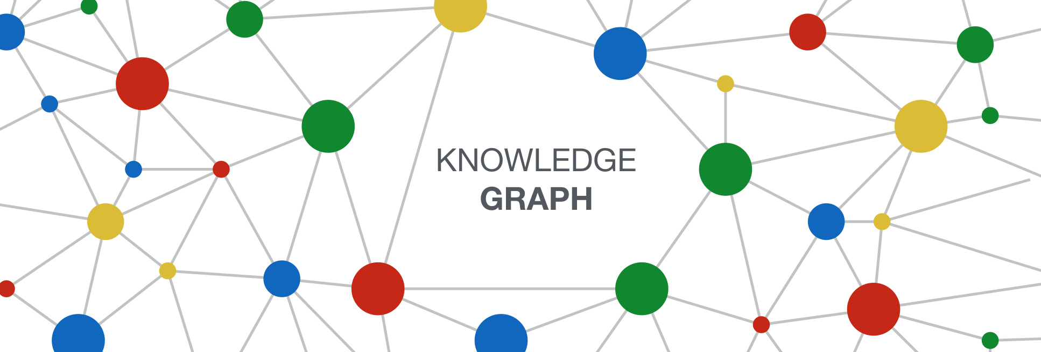
Pipeline for constructing Financial Knowledge Graph
Name :: Kamal Choudhury
Roll No. :: 1801CS27

Slide 2
Introduction
Question answering, fact checking, and data integration
Constructing knowledge graphs by extracting information from unstructured information sources
Format like (subject, predicate, object) triples in a graph
This structure can be stored, queried, and maintained as a graph, with the entities as vertices and relations/links as directed edges
Motivation :: Proliferation of financial news sources reporting on companies, markets, currencies, and stocks
Knowledge Graph extraction pipeline tailored for the financial domain
Growing interest in generating domain targeted structured representations of financial and business entities

Slide 3
Earliest Attempts
Interest in having structured representations for financial and business
Vision led to Crunchbase
Cross-domain KGs such as DBpedia, Freebase, NELL, and BabelNet contain encyclopedic knowledge covering real world entities across different domains
They were either manually curated (e.g., Freebase)
Automatically created, from semi-structured textual sources such as Wikipedia infoboxes (e.g., DBpedia)
unstructured text on the web (e.g., NELL).
Efforts for domain targeted KGs
But few types of business transactions like ascquisitions and funding rounds.

Slide 4
Related Work and Comparisons
While manually defining an ontology → high precision but requires experts
OpenIE → Relational phrases but not verb tense and conjugation
SRL → relations between arguments and their predicates
The KB built Benetka used a pipeline that consisted of:
(1) a grammar for monetary value recognition
(2) SRL for economic event identification
(3) entity recognition via DBpedia, Crunchbase and Freebase
(4) date extraction via a temporal tagger.
It extracted structured representations of economic events in the form of (subject, predicate, object, monetary value, date) quintuples from the New York Times Annotated Corpus (NYTC)

Slide 5
Goals
Developing knowledge graph extraction pipeline
Formulating noisy text cleaning as a sequence labeling problem and building a CRF model to remove noisy text spans which help improve the precision of the pipeline.
Building a dictionary of structurally and semantically constrained sense disambiguated financial predicates
Conducting ablation studies to examine the effect of the different modules of the pipeline.

Slide 6
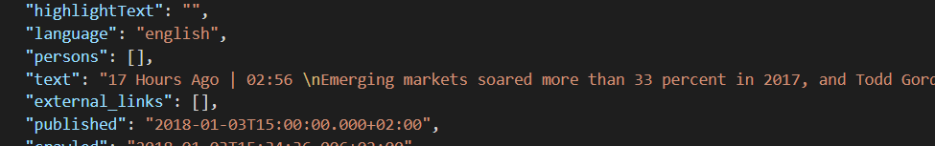
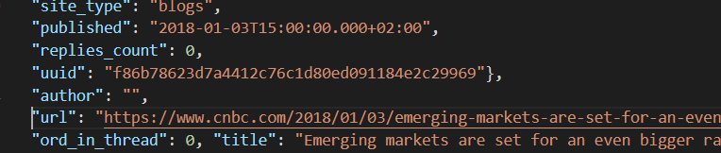
Dataset Used
Financial news corpus: US Financial news 3 dataset containing ∼ 306k news articles collected from Bloomberg.com, CNBC.com, reuters.com, and wsj.com between January and May 2018; Arranged in folders of 5 for 5 months and each contains a json file containing a lot of detailed information. (The date of the news reported, the link to website, text of the news etc.)
Financial Times Lexicon : Many Financial words and phrases & used to identify and minimize overly specific arguments

Slide 7
Pipeline
Text Preprocessi& Cleaning
Coreference Resolution
Named Entity Recognition
Semantic Role Labelling
Financial Predicate Dictionary Filtering
Fact Scoring
Argument Minimization
Temporal Argument Parser
Argument Validation
Appositions + Coordinating Conjunctions
Pattern Extraction

Slide 8
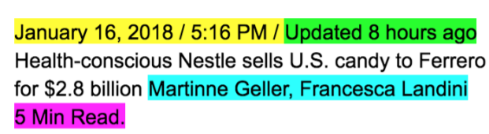
Text Pre-processing & Cleaning (CL)
Standard NLP cleaning by removing brackets, parentheses, quotes and other punctuation marks
New task → Identify and remove noisy text spans such as the publication date, the time the article was last updated, etc.
Sequence labeling problem where tokens in a sentence are assigned a sequence of labels. (IOB tagging and linear CRF chain)
Manually annotation is to be done.
Labelled sequences of tokens using token features (POS tags & neighbours) using stanza library

Slide 9
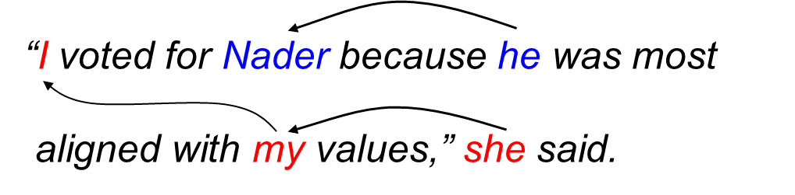
Coreference resolution
Resolved references to the same entity using the co-reference resolution system (COREF) integrated in the SpaCy NLP library (Loaded language “en_core_web_sm”)
The model used along with spacy was NeuralCoref (using deep reinforcement learning)

Slide 10
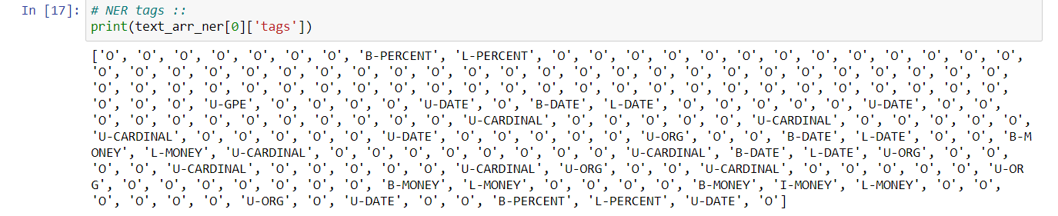
Named entity recognition
Identified named entities using the AllenNLP named entity recognition (NER) system (based on Bidirectional LSTM neural architecture with CRF layer ) with the model name being → “tagging-fine-grained-crf-tagger”.
This model identifies a broad range of 16 semantic types in the input text.
A dictionary is returned containing the tags and words

Slide 11
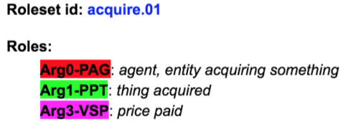
Semantic Role Labeling (SRL).
Extracted semantic relationships between entities.
Consider “Whole Foods was acquired by Amazon in 2017 for $13.7 Billion”.
OpenIE extracts (Whole Foods; was acquired; by Amazon; in 2017; for $13.7 Billion).
SRL extracts acquire.01(agent: Amazon, thing acquired: Whole Foods, price paid: $13.7 Billion, Temporal argument: 2017)
Helped to impose structural and semantic restrictions improving precision
An optional argument is the price paid whose type should be MONEY.
For Now, Used an SRL_BERT to find the semantic frames (based on 2009 CoNLL dataset)

Slide 12
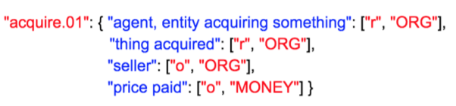
Financial predicate dictionary filtering
Filter out domain irrelevant predicate argument structures using a dictionary of financial predicates (filters out predicate argument structures that are not financially relevant)
This dictionary lists the sense disambiguated predicates along with structural & semantic constraints.

Slide 13
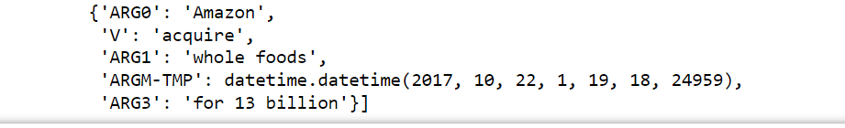
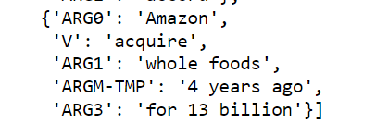
Temporal Argument Parsing
Many of of the SRL extracted relations contain temporal arguments AM-TMP such as today, last year, 3 months ago.
Passed these arguments to a date parser library that performs relative parsing of localized dates in numerous formats to produce a standard date format
Used the publication date as the relative base
For now only one such case was there.

Slide 14
Appositions and co-ordinating conjunctions
Using dependency parser found the structure of the sentence.
Interdependencies of various words and their relations among each other.
Focus on 2 types of speech → i) Appositions :: ii) Co-Ordinating Conjunctions
Appositions → An appositional modifier of a noun is a nominal immediately following the first noun that serves to define, modify, name, or describe that noun (Appos in parser). Used to add some more facts.

Slide 15

A coordinating conjunction is a word that joins two elements of equal grammatical rank and syntactic importance. (Cconj in parser). Used to breaking facts into many facts.

Slide 16
Pattern Extraction
In addition to the verb mediated relations extracted via semantic role labeling, we extract noun mediated relations via pattern based extractor
Using RelNoun portion from Openie
Demonyms (words derived from the name of a place to identify its residents or natives) and Compound Relational Nouns (Relational Nouns with pre-modifier example :: “Jeff Bezos, CEO of Amazon”)
Adding new type constraints such as ORG and PER
Whenever pattern matched it is added to the facts

Slide 17
Argument Minimization
First drop tokens that are considered safe to drop like determiners, possessives, adjectives modifying named entity PER except demonyms.
Then find instances of the noun phrase pattern [adverbial|adjective] + Noun+ and then for every instance of this pattern, we mark the root and all its noun modifiers as stable
Then enumerate sub sequences of this instance where at least one noun is retained. We then query these sub sequences against a dictionary, if it is found in the dictionary, then all its tokens are marked as stable.
After querying all sub sequences, tokens that are not marked as stable are dropped.
Financial Times financial lexicon containing many nouns and phrases which are financially related is used as the dictionary. This ensures that tokens that are meaningful and important in the financial context are not dropped

Slide 18
Others
Argument Validation → Sometimes wrong argument passed
Fact Scoring → score the predicate argument structures to reflect our confidence, by training a binary logistic regression classifier using over manually labelled data.

Slide 19
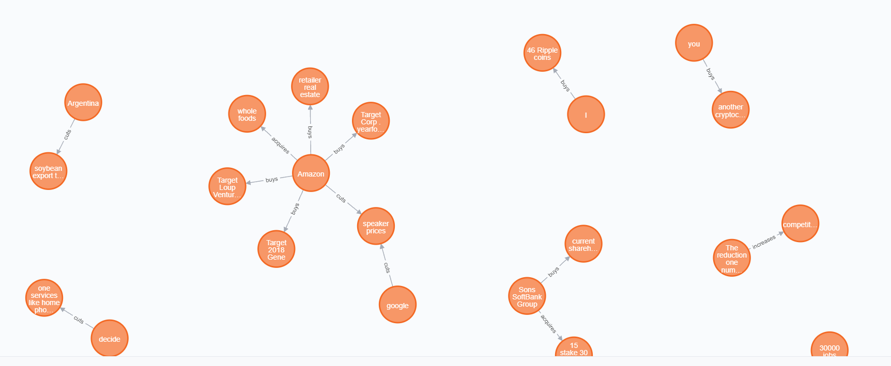
KG using Neo4j

Slide 20
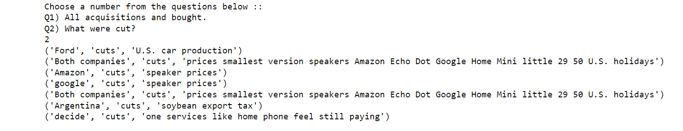
Query Interface

Slide 21
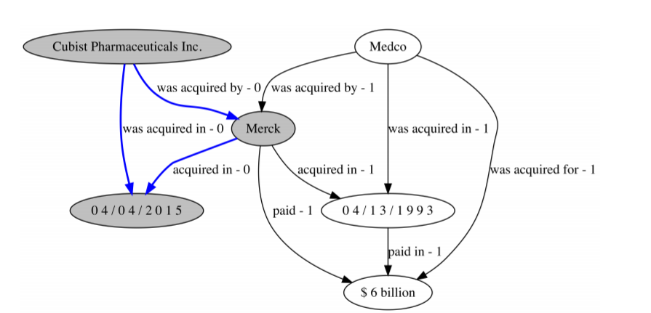
One Example → Companies acquired by german drugmakers

